Slide 1
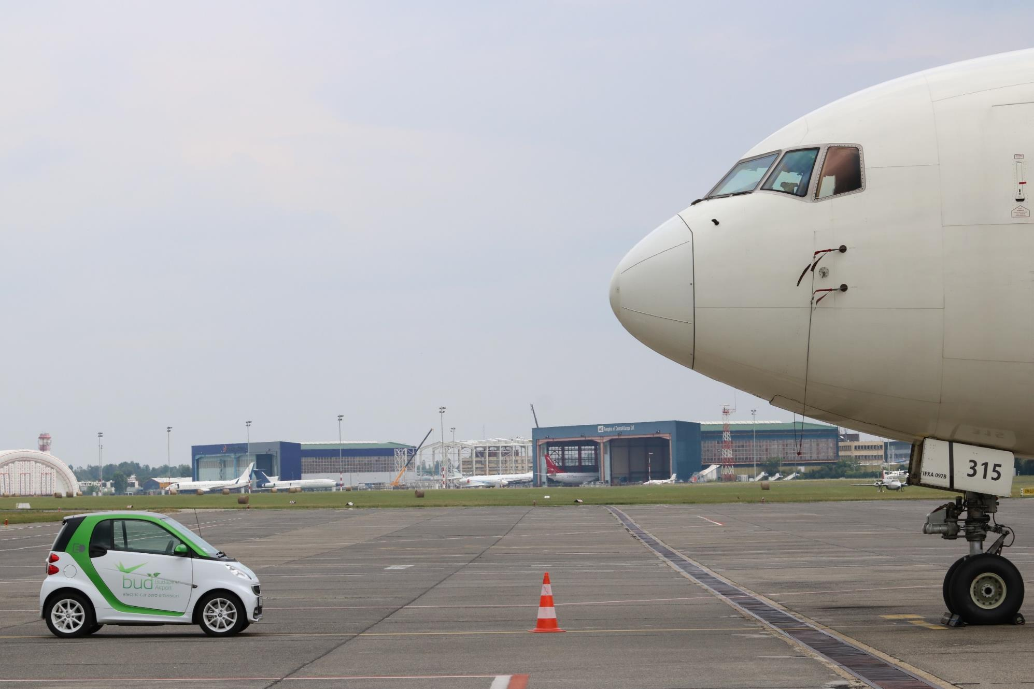
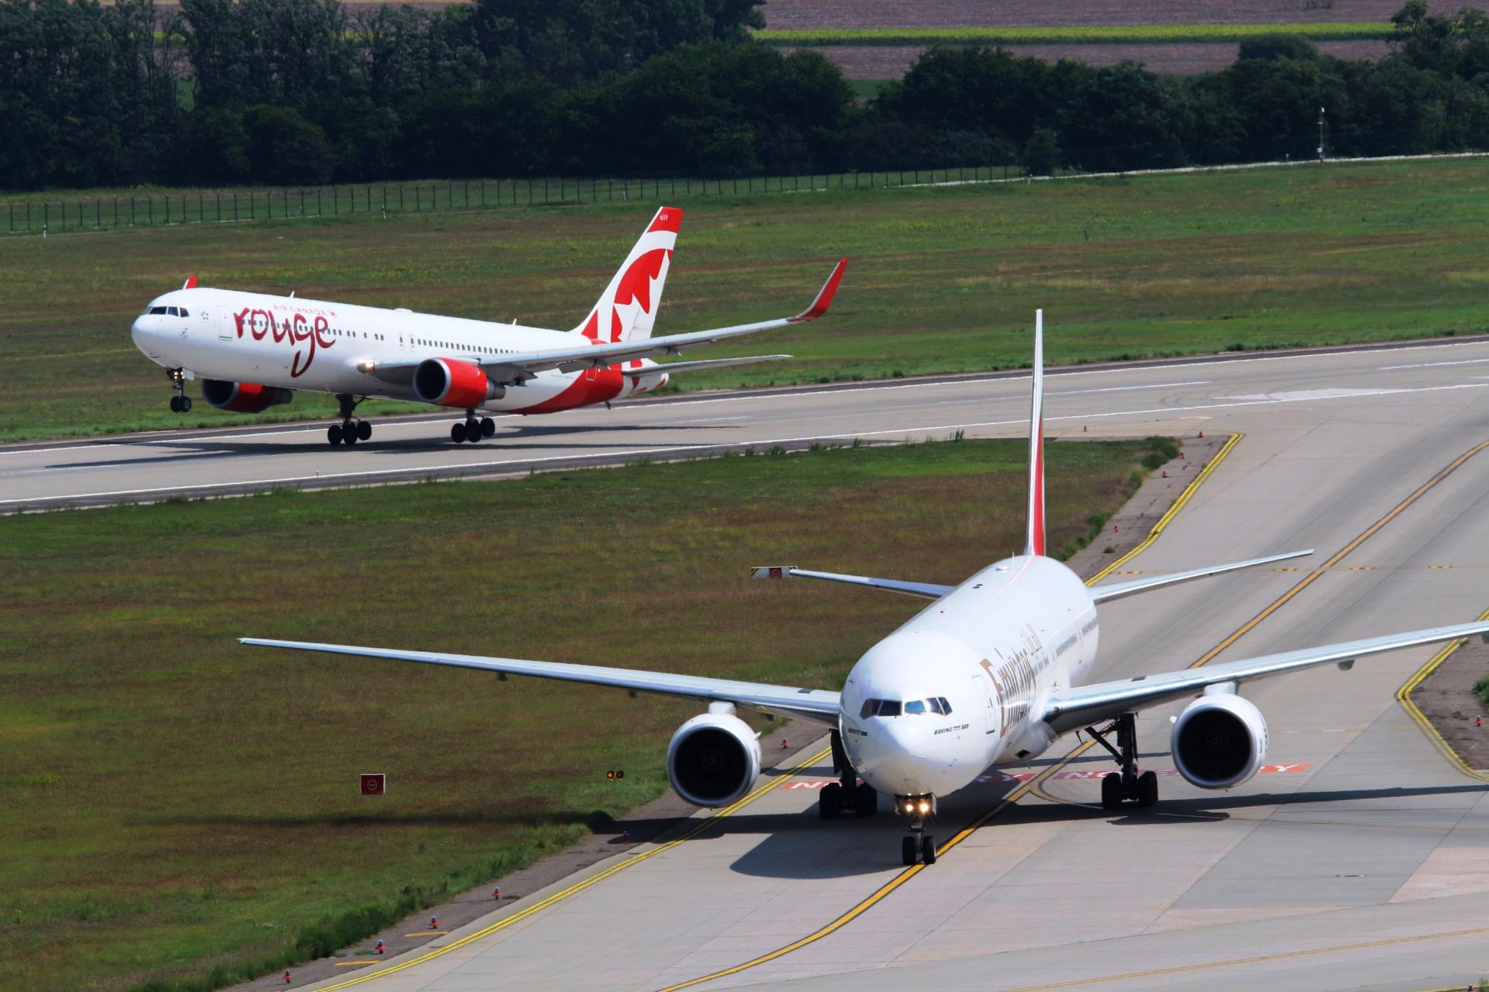

Budapest Airport Update – 28/07/2020
Kam Jandu, Chief Commercial Officer

Slide 2




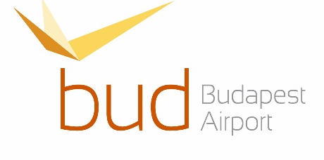
bud: ownership structure
Canadian State
Government of Singapore
Province of Québec
Government of Singapore Investment Corp. / Malton Ivestment Pte Ltd.
Caisse de dépot et
Placement du Québec
AviAlliance Gmbh owned by
PSP Investments
55.438%
23.334%
21.228%
Notes:
Concession time remaining is over 60 years and they are committed

Slide 3
Traffic evolution 2012 – 2020 FC
Passenger traffic grew by 90% from 2012 to 2019, but in 2020 it will decrease by 56% according to our forecast.
Air traffic movements increased by 40% from 2012 to 2019, but in 2020 it will decrease by 45% according to our forecast.
Notes:
Consistently grew, often in double digits
Fc this year is under 8 million but this can change of course
ATM’s dropped of course but airlines are user smaller planes and cargo movements grew

Slide 4
Passenger Traffic
Notes:
2020 was ok but then….
Fell off a cliff as they say
Recovery is gradual but restrictions and changes are having a negative impact – we are confident though of getting between 7-8 mio pax this year
Country split for 2019 and 2020 June deviated but the 2019 split should become the norm

Slide 5









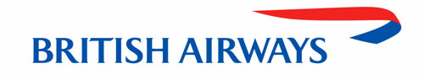












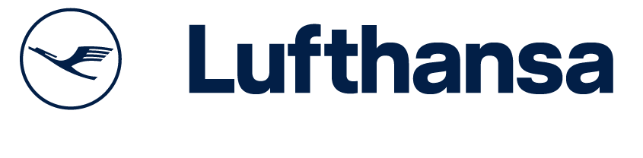
99 destinations, 23 airlines in AUG 2020
40 destinations
62 destinations
Amsterdam, Basel, Geneva, London, Manchester
Dusseldorf, Hamburg, Stuttgarr
Dubrovnik, Seoul, Warsaw
Birmingham, Manchester
Copenhagen, Oslo
Frankfurt, Munich
Notes:
This is great – shows airlines commitment and whilst less than previous years remains a good indicator
BUD have invested several hundreds of thousands of euros of own money in incentives to encourage earlier return here for airline than others. E.G. jet2.com are coming to BUD and not prague this year – a huge change

Slide 6
Passenger Traffic Forecast 2020 - 2024
Annual change -56.3% 83.6% 21.0% 8.3% 5.9%

Slide 7
Benchmark 2020 April YTD

Slide 8



New destinations in SS20
Mykonos, 2 weekly
Santorini, 2 weekly
Abu Dhabi, 2 weekly
Menorca, 2 weekly
Dubrovnik, weekly
Varna, weekly
Luxembourg, 2 weekly

Slide 9
Number of routes 2015 – 2020
AUG

Slide 10
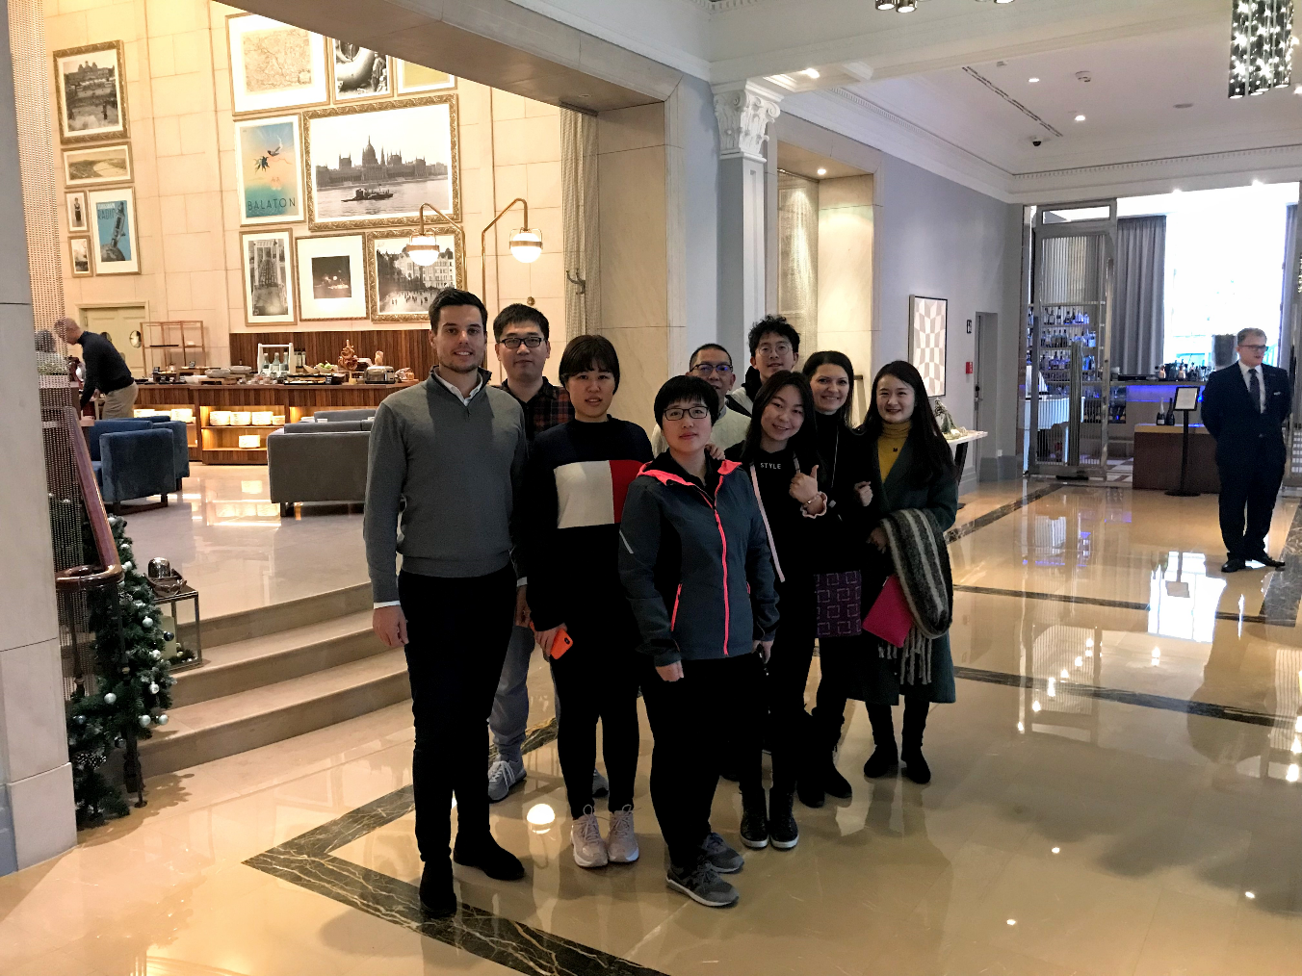
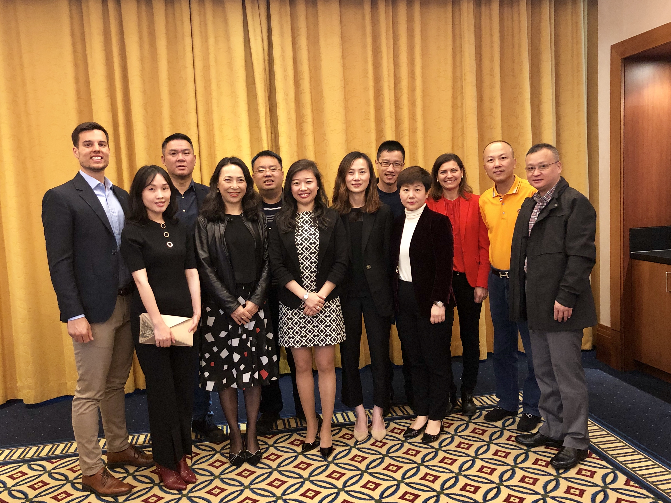
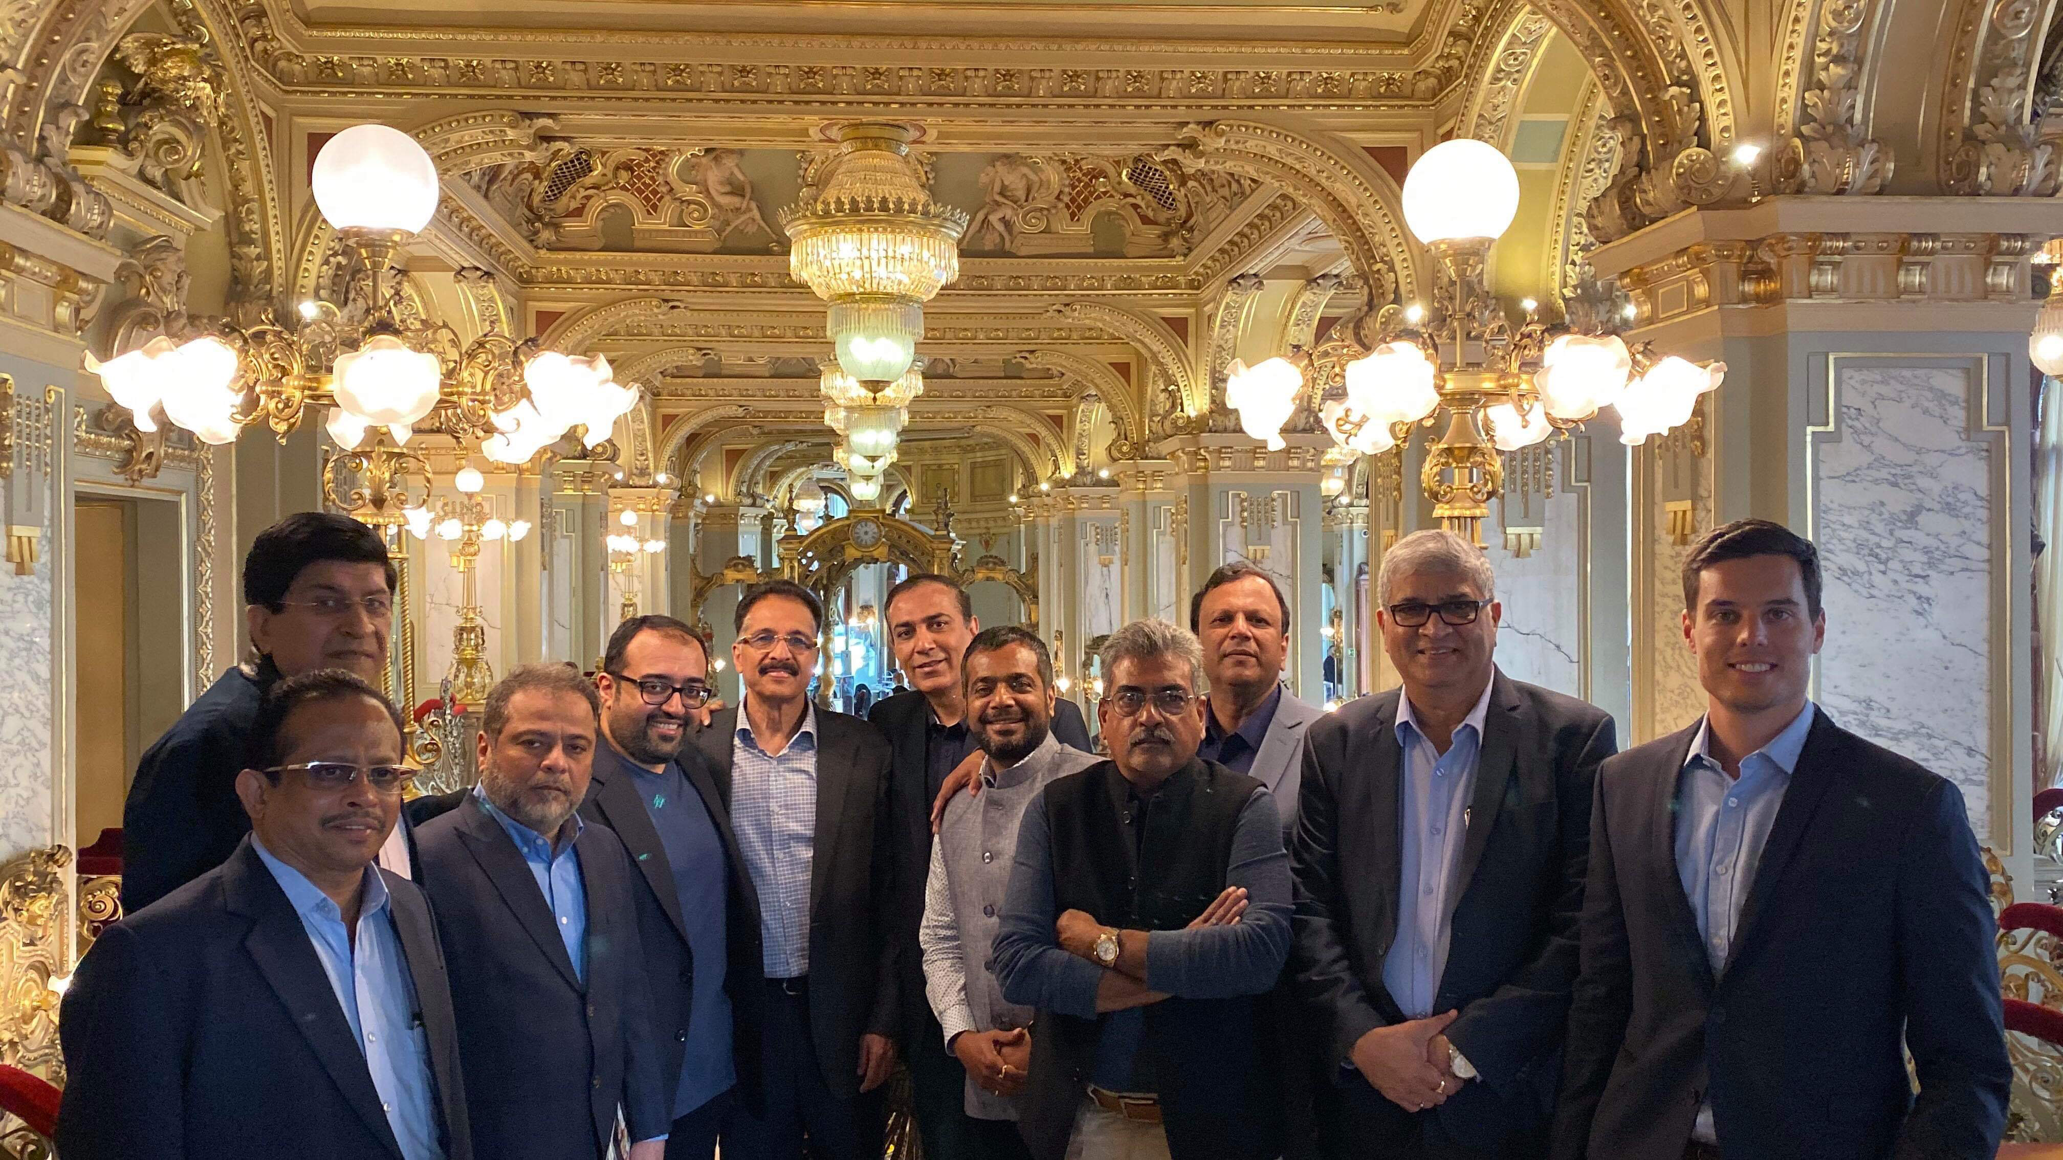

Supporting each other
Air China travel trade FAM trip 2018
KLM Xiamen travel trade trip
2019
Emirates India travel trade FAM trip
2019
BUD cooperates with stakeholders such as airlines, hotels and the Hungarian Tourism Agency to welcome travel trade and media FAM trips from all around the world.
Framework: tickets and recruitment by the airline and BUD, accommodation by hotels, transfer and program by HTA and BUD initiates and supervises the efforts.
Love Actually film shooting at BUD
50 million views via Chinese media

Slide 11





COVID measures
Hygiene measures
Social distancing measures
Health and safety of staff and passengers
HR measures
Communication

Slide 12
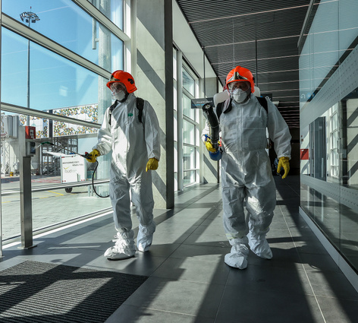
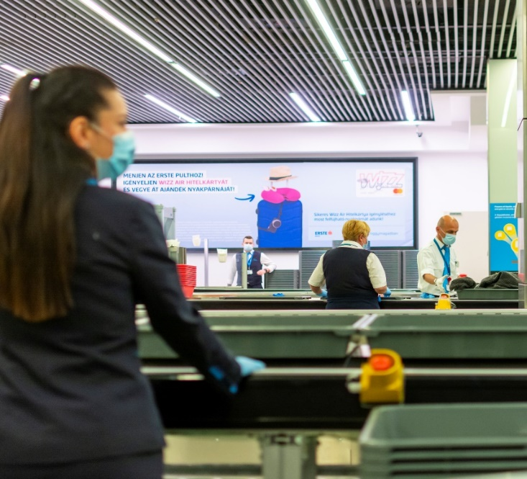
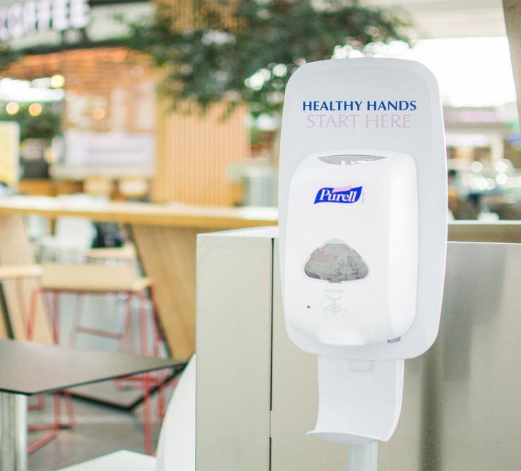
Hygiene measures
Measures taken
Hand disinfectants: an increased number of hand disinfectants improve hygiene.
Sanitizing mats at entry doors: will help prevent contamination on passengers’ shoes.
Enhanced cleaning: higher frequency cleaning for all passenger areas including security trays, offices using disinfectants.
Ventilation system cleaning: to avoid the spread of pathogens and improve air quality.
Protective equipment: all frontline staff are wearing protective equipment
Body temperature measurement on arrivals: by measuring passengers body temperature, possible virus hosts can be identified.

Slide 13
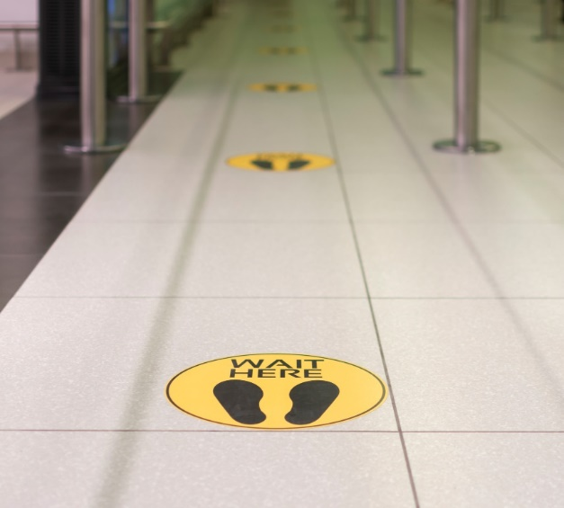
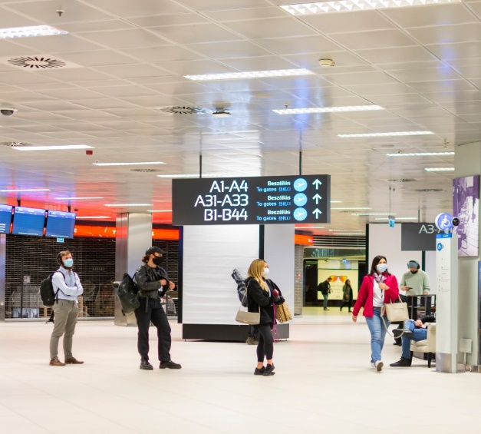
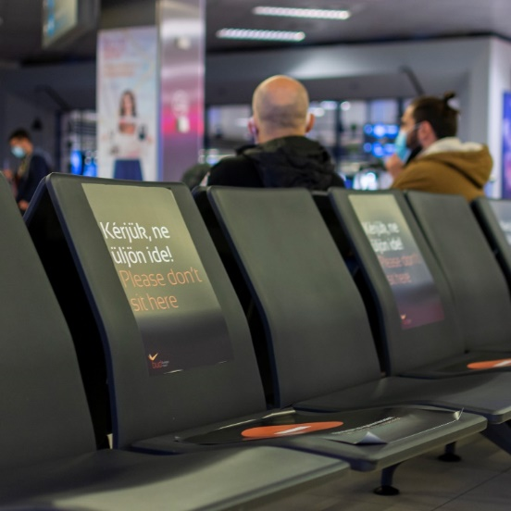
Social Distancing measures
Measures taken
Flow control: controlling passenger flows to prevent crowd gathering
Queue control stickers: floor stickers to maintain social distancing levels at queuing areas (check-in, passport control, security screening, boarding, baggage reclaim area)
Information displays throughout the terminal to remind passengers of the 1.5 metre social distancing
Using only every second lane at check-in, security and boarding when possible
Rearranged seating: seats spaced further apart with every second seat blocked on benches.
Passengers only in the terminal: meeters and greeters should not enter the building.
Plexiglass separators: installing plexiglass where passengers come into contact with staff (check-in counters, security re-check, boarding, shops and other service providers).

Slide 14
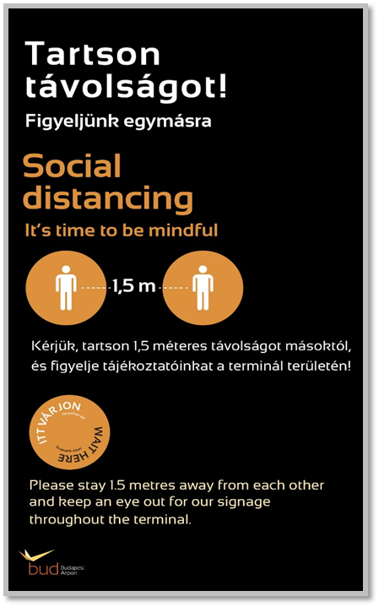
Communication
Measures taken
Intensive media communication in order to inform the public in general
Online communication: sharing these new practices through social media to raise awareness among passengers.
Informing tenants: communicating with business partners to harmonize preventive measures and to keep them updated.
Information display: placing information signs with clear messages along the passenger journey to inform and remind passengers of the 1.5 meter social distancing rule.
Mindful tone of voice: to comfort passengers and gain their trust for cooperation.
Passenger information
Calling passengers’ attention to the following precautionary measures
  Entry only for passengers – entry not recommended for meeters and greeters
  The use of face masks
  The use of online check-in
  The use of self-service baggage drop-off (wherever available)

Slide 15


